Slide 1
Forecasting the output of wind generation and improving operation of wind Turbines using Artificial intelligence
Presented by
Aishwarya G L

Slide 2
ABSTRACT
Applying artificial intelligence (AI) to wind-turbine data is becoming more prevalent and there is a growing number of use cases for the technology.
Application is mainly for reducing wind-turbine maintenance practices and can result in increased efficiency, better spare-parts forecasting, reduced downtime, and lower unplanned Maintenance costs.
This system will collect data directly from the wind farms with monitoring and report generation in real-time, to improve decision making and reliability.
Create AI models for better forcasting.

Slide 3
EXISTING SYSTEM
The current system is using software only for maintaining
Employ attendance- Software is able to mark the employ attendance and managing the leave register.
Staff management- Manually and automatically arranges the shift of the employees and maintaining the staff in a HR manner.
Expense management- Accounting the overall wind mill expense and recording the amount of energy generated. Also calculate the profit and loss made by the wind mill.

Slide 4
PROPOSED SYSTEM
The proposed method proved to provide an effective way of fault identification at minimum cost and minimize the maintenance cost as well by saving the components prior to the occurrence of the intensive faults.
The accuracy of the method and the error rate of the method were considerably low compared to the existing methodologies.
AI models are used for maintaining wind mills operations.
Here software serve to quickly identify abnormalities and notify the wind-farm operator. Many types of forecasts are possible, including power production, availability, spare parts needs, and other such use cases.

Slide 5
OPERATING ENVIRONMENT Hardware requirements
Processor : Intel i5 8th Gen
RAM : 16GB ddr4
Hard disk : 2048 GB SSD
Drives : CD ROM, C-type Port, USB 3.1*2 Port
Display Size : Compatible Size (Recommend 15’inch)
Screen Resolution : 1920*1080 Pixels
Keyboard : Wireless Enabled Keyboard (Recommend: Logitech)
Keyboard Mouse : Wireless Enabled Mouse (Recommend: Logitech)
Monitor : Touch Capacity LED Monitor
Dedicated Graphics Card : Nvidia GeForce GTX 1050 4GB DDR5

Slide 6
OPERATING ENVIRONMENT Software requirements
Operating System : Windows (7/8/10)/Ubuntu (14/16/18/20)
Software Drivers : Wi-Fi drivers .Bluetooth Drivers, Visual Studio Drivers Nvidia GeForce Graphics drivers, Intel Drivers and Camera Drivers
Programming Language : Python
IDE : OpenCV, keras
Scripting Languages : HTML, CSS, JavaScript
Web Browser : Google Chrome
Front-End : Python, Django
Back-End : My SQL

Slide 7
MODULES
Manager
Employ Management
Wind mill management
Power production
Service management
Maintenance and spare parts prediction

Slide 8
MANAGER
Employ Management
Manager can manage all day today activities.
Plant manager add employ
Manager can view the attendance, salary and also can edit employ details.
Also manager can block or unblock employees.
Generate wages report, update hourly wages. Calculate employee efficiency and report based on daily log. Update job sheet and verify and approve job sheet

Slide 9
MANAGER
Windmill management
Plant manager can add new wind mill turbines.
plant manager can add parts name, weight, material used etc. In this function windmill specifications can be recorded, like power efficiency, noise level, rotor diameter, blade length, swept area, hub height and rotor weight.
Power production
Power production report generation based on the auto updated power generation log.
Predict the amount of power will be generate. Also plant manager can manage the power outcome from the windmill.

Slide 10
Manager
Service management
In service management function it will update daily machine status, service history, periodic checkup update.
Plant manager can inspect day today service of employees and the machines as well.
Check parts availability, service validity and current status. Also record wind mill id of damaged or serviced report for further examinations.

Slide 11
Maintenance and spare parts prediction
Determine the condition of equipment and predicting when maintenance should be performed. Usage history data is an important indicator of wind mill condition. It also wants information about maintenance and service history. All this information is updated periodically from the maintenance portal.
Linear Regression Algorithm is used to find the remaining life of a machine parts.

Slide 12
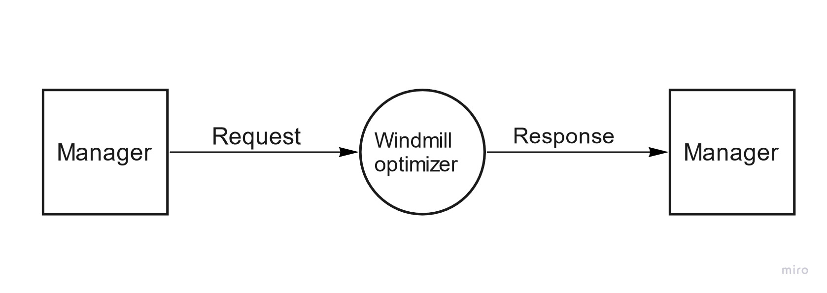
DATA FLOW DIAGRAM
Level 0 (Context level)

Slide 13
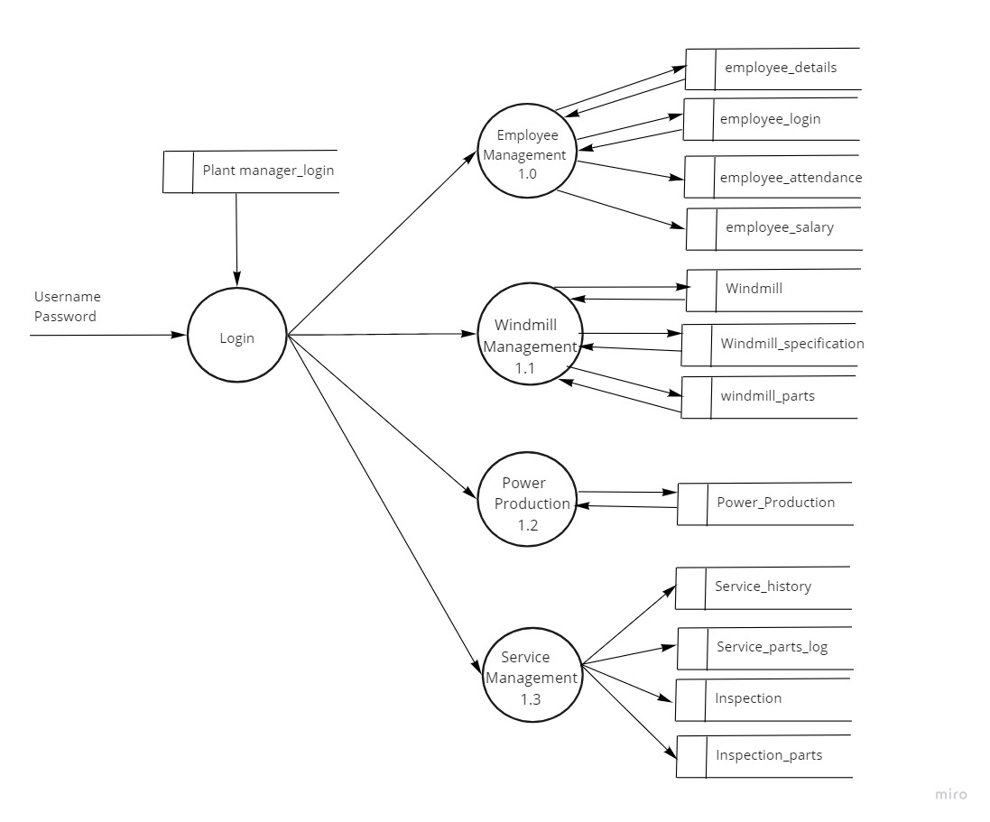
Level 1 Login

Slide 14
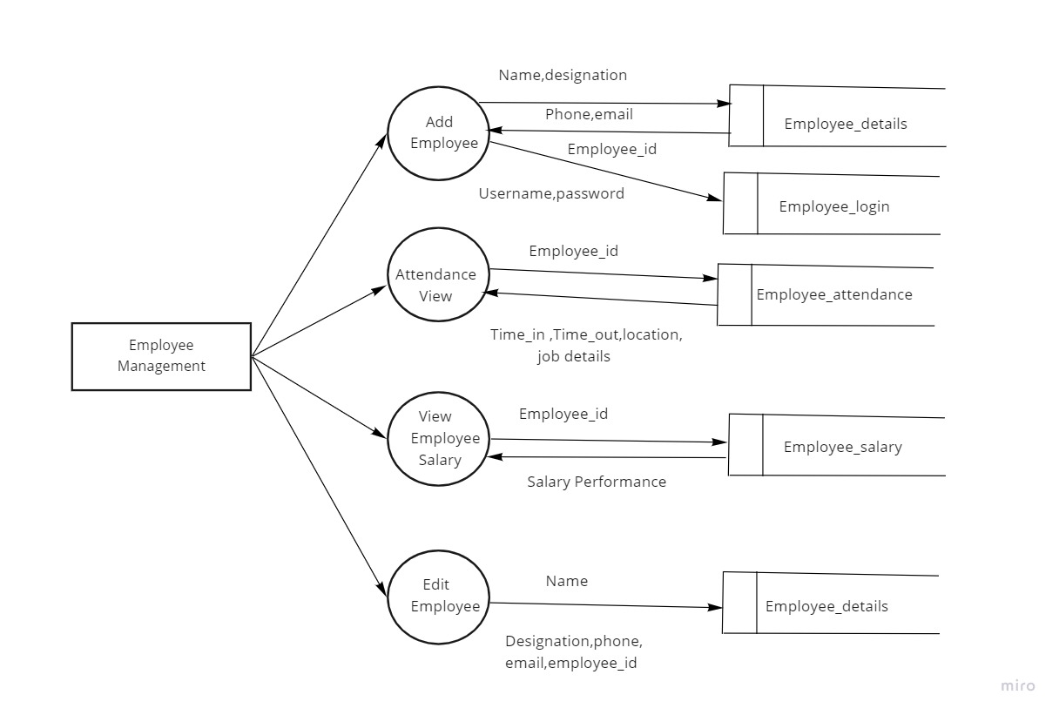
Level 1.o Employee managment

Slide 15
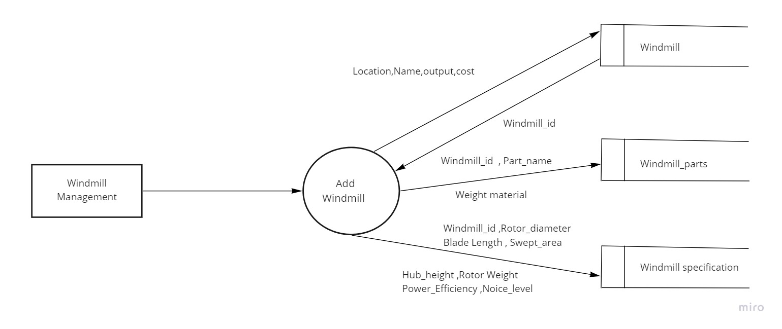
Level 1.1 Wind mill managment

Slide 16
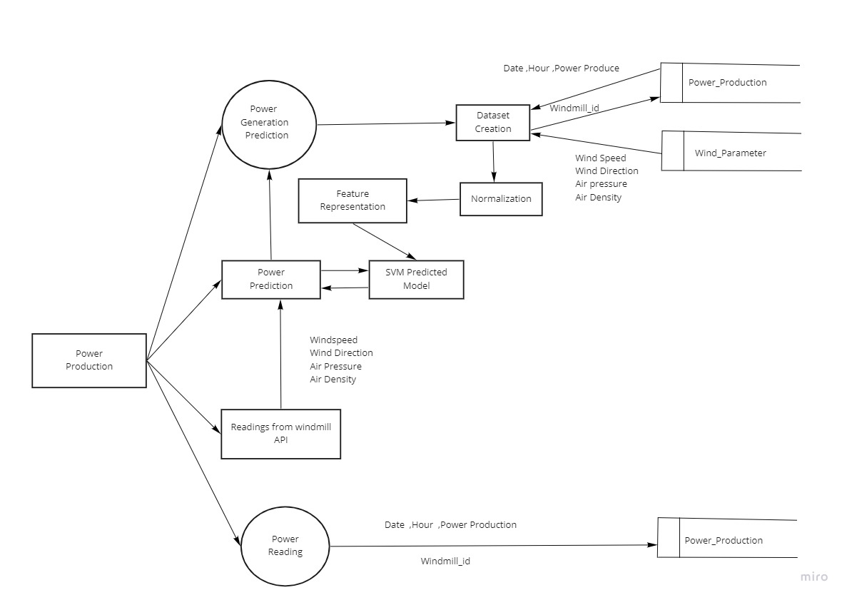
Level 1.2 Power production

Slide 17
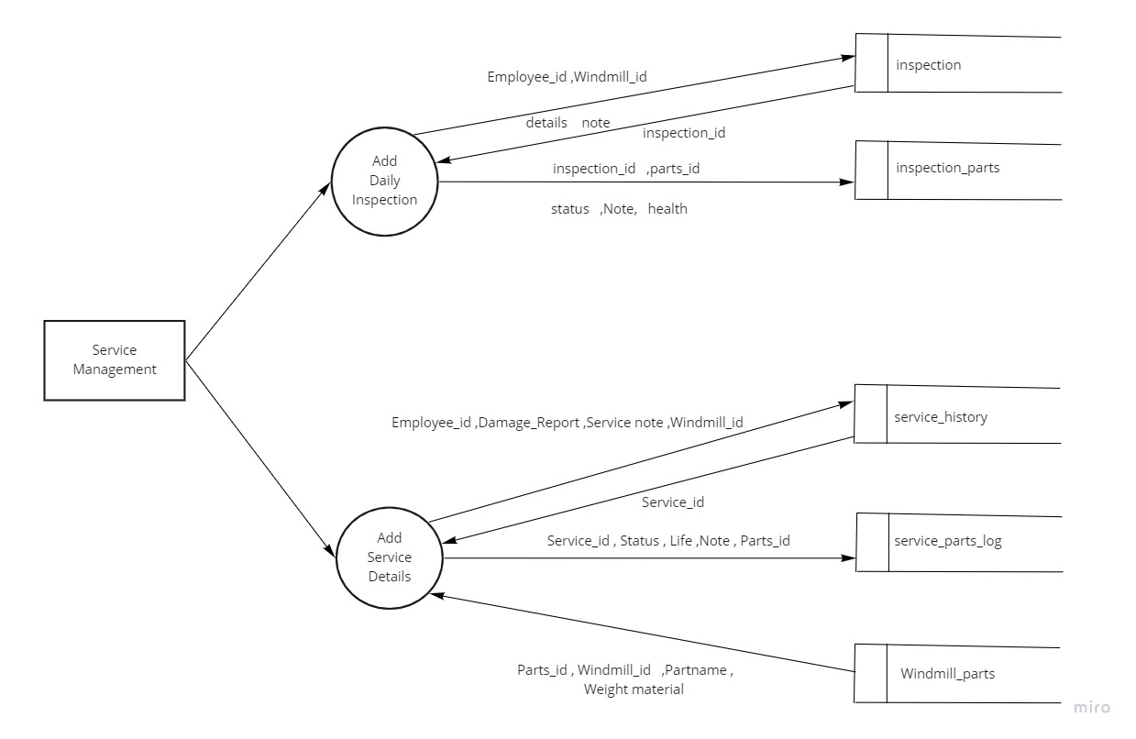
Level 1.3Service management

Slide 18
Plant_manager_login
Table Name: Plant manager login Primary key: login_id
Description: Plant manager login and it contains 3 fields
Field name | Data type
login_id | Int
User name | varchar(20)
Password | varchar(20)

Slide 19
Employee Details
Table Name: Employee Details Primary key: Employee_id
Description: Employee details and it contains 4 fields
Field name | Data type
Employee_id | int
Name | varchar
Designation | varchar(20)
email | varchar(20)

Slide 20
Employee login
Table name: Employee login Primary key: employee_login_id Foreign key: employee_id
Description: Employee login and it contains 4 fields
Field name | Data type
employee_login_id | varchar(20)
Password | varchar(20)
employee_id | int

Slide 21
Wind Mill
Table Name: Wind Mill Primary key: wind_mill_id
Description: Wind mill details and it contains 6 fields
Field name | Data type
wind_mill_id | Int
Location | varchar(100)
Name | varchar(100)
Output | double
Cost | double
Status | varchar(20)

Slide 22
Wind_Mill_Specification
Table name: Wind Mill Specification Primary key: windmill_sp_id Foreign key: wind_mill_id
Description: Wind mill specification and it contains 10 fields
Field name | Data type
windmill_sp_id | int
wind_mill_id | int
Rotor diameter | double
Blade length | double
Swept area | double
Hub height | double
Rotor weight | double
Power efficiency | double
Noise level | double
Warranty | double

Slide 23
Wind_mill_parts
Table name: Wind mill parts Primary key: Parts_id
Description: Wind mill parts details and it contains 3 fields
Field name | Data type
Parts_id | int
wind_mill_id | int
Part_name | varchar(20)

Slide 24
Employee_attendance
Table name: Employee attendance Primary key: attendance_id Foreign key: employee_id, location_id
Description: Employee attendance and it contains 6 fields
Field name | Data type
attendance_id | int
time_in | datetime
time_out | datetime
employee_id | int
location_id | int
Job_details | text

Slide 25
Employee_Salary
Table name: Employee salary Primary key: salary_id Foreign key: employee_id
Description: Employee salary and it contains 4 fields
Field name | Data type
salary_id | int
employee_id | int
Salary | double
Performance | double

Slide 26
Power_production
Table name:Power production Primary key: Power_production Foreign key: wind_mill_id
Description: Power production details and it contains 5 fields
Field name | Data type
Power_production_id | Int
wind_mill_id | Int
Date | date
Hour | Int
Power_production | double

Slide 27
Service_History
Table name: Service history Primary key: service_id Foreign key: employee_id, wind_mill_id
Description: Service history and it contains 6 fields
Field name | Data type
service_id | int
employee_id | int
damage_report | text
service_note | text
wind_mill_id | Int
date | datetime

Slide 28
Service_parts_log
Table name: Service parts log Primary key: service_parts_log_id Foreign key: service_id, parts_id
Description: Service parts log and it contains 6 fields
Field name | Data type
service_parts_log_id | int
service_id | Int
status | varchar(20)
Life | double
Note | text
Parts_id | int

Slide 29
Inspection_parts
Table name: Inspection parts Primary key:inspection_parts_id Foreign key: inspection_id, parts_id
Description: Inspection parts and it contains 7 fields
Field name | Data type
inspection_parts_id | int
inspection_id | int
parts_id | int
Status | varchar(30)
Note | text
Health | varchar(50)
Action | varchar(50)

Slide 30
PROJECT SCREENSHOTS

Slide 31
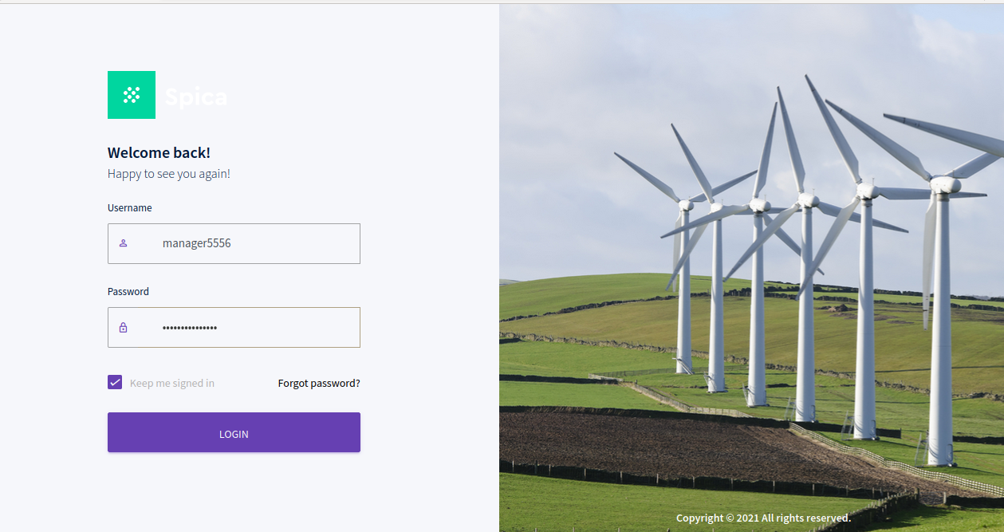
USER LOGIN

Slide 32
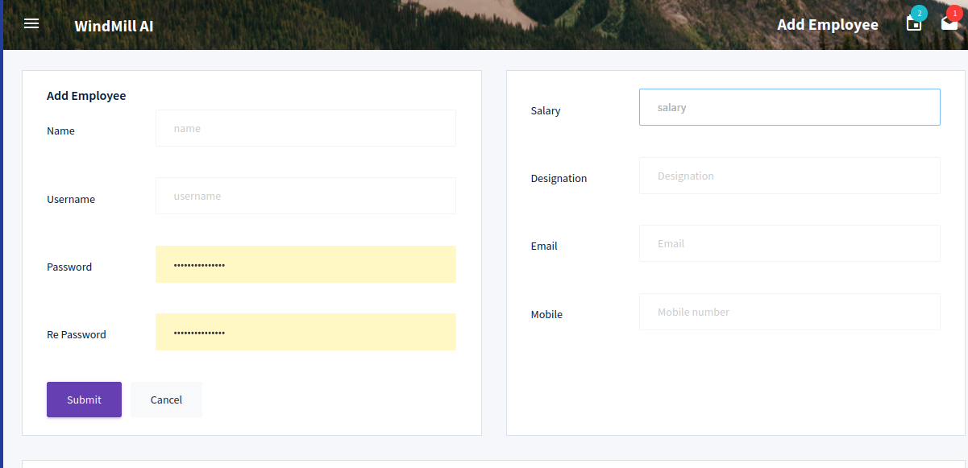
ADD EMPLOYEE

Slide 33
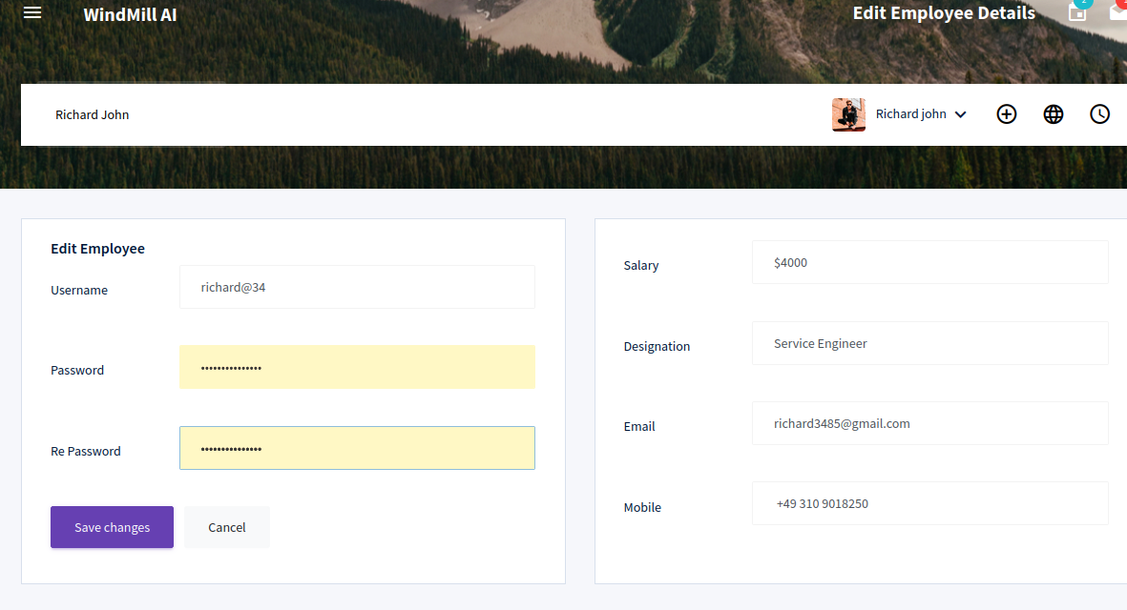
EDIT EMPLOYEE

Slide 34
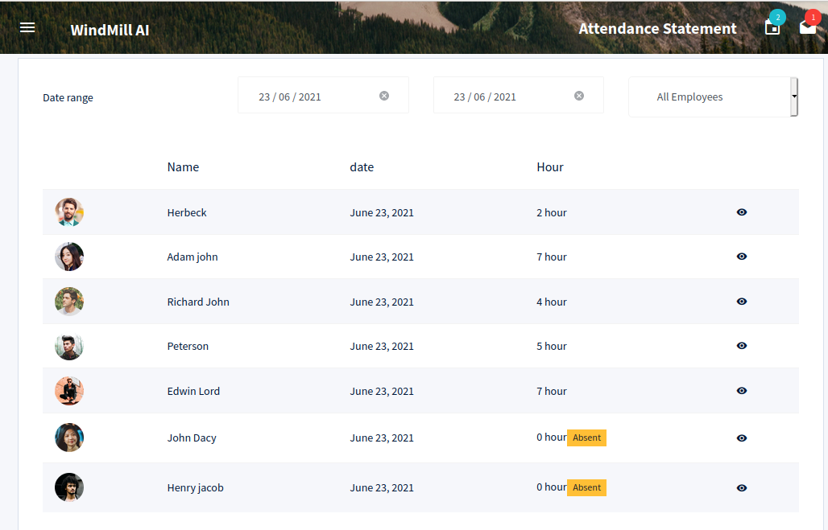
ATTENDANCE DETAILS

Slide 35
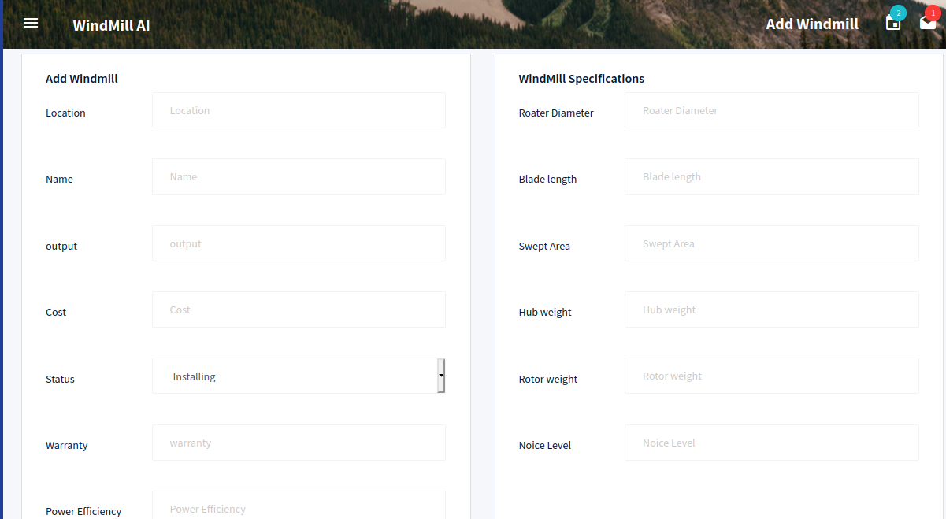
ADD WINDMILL

Slide 36
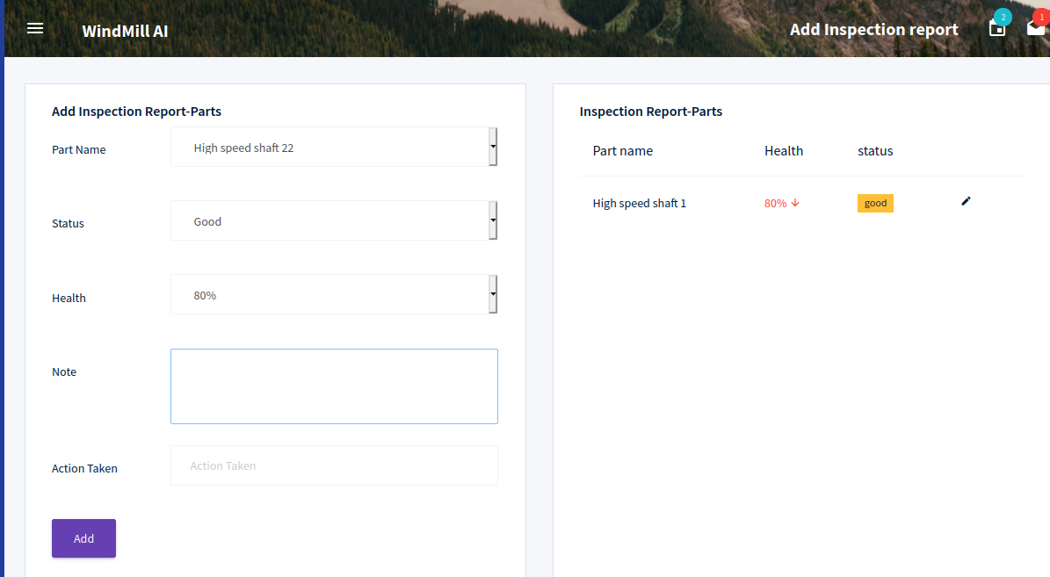
ADD INSPECTION PARTS

Slide 37
ADD INSPECTION PARTS

Slide 38
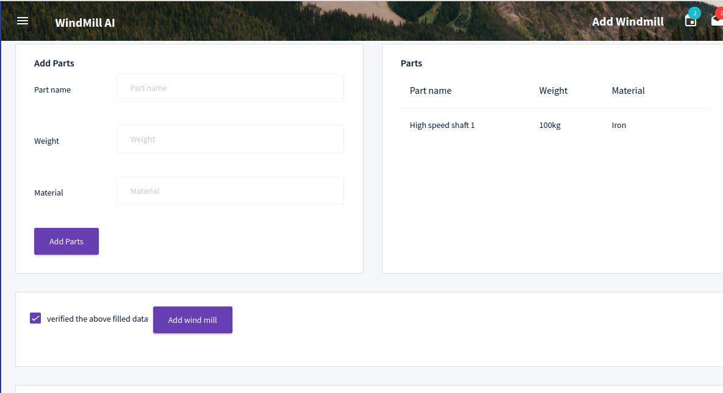
ADD SPARE

Slide 39
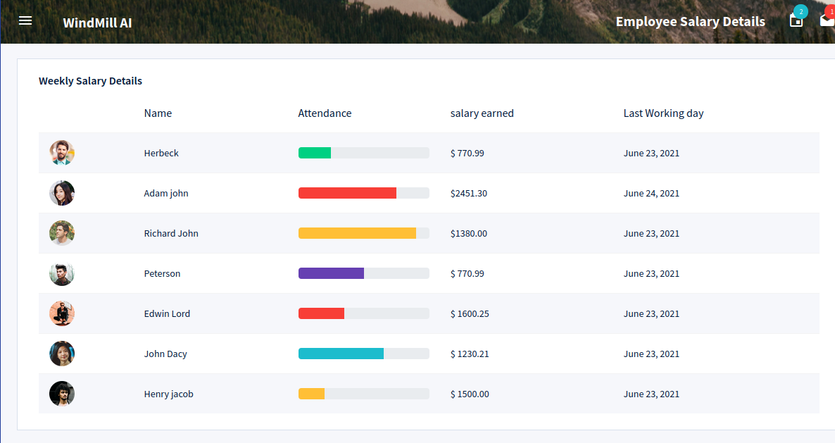
SALARY DETAILS

Slide 40
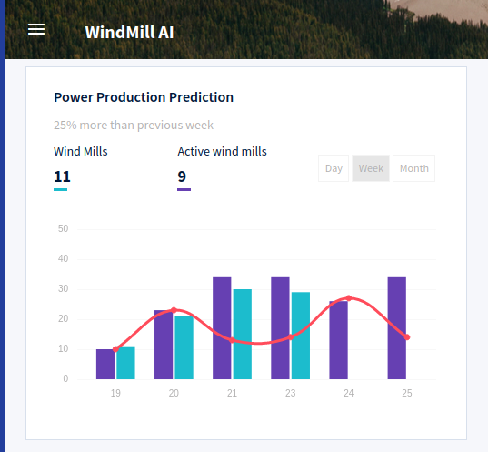
POWER PRODUCTION

Slide 41
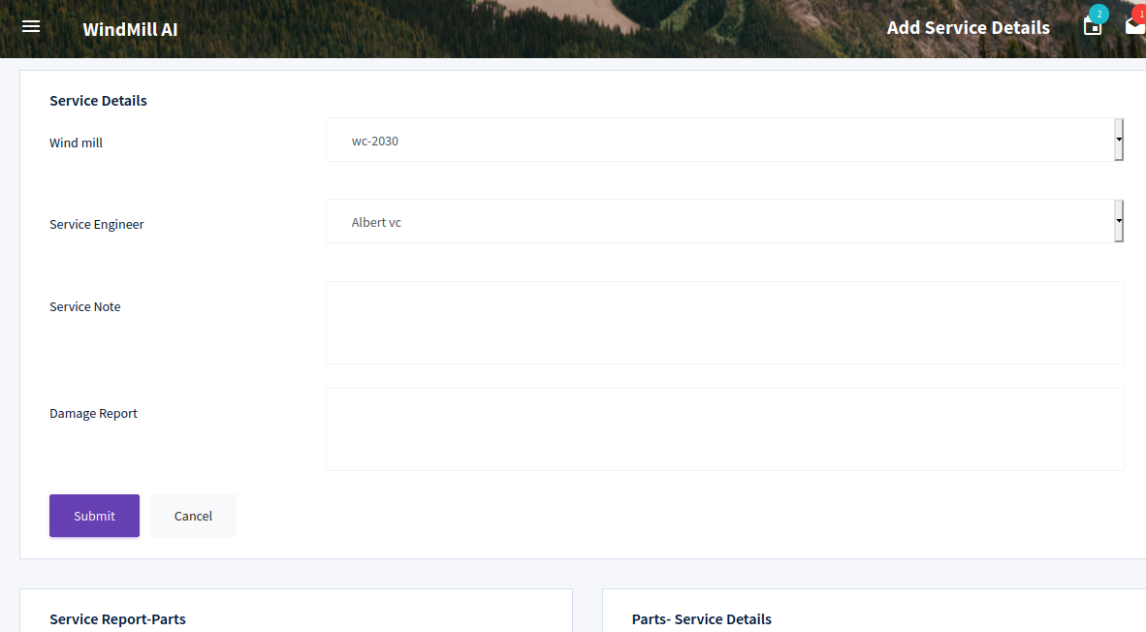
SERVICE REPORT 1

Slide 42
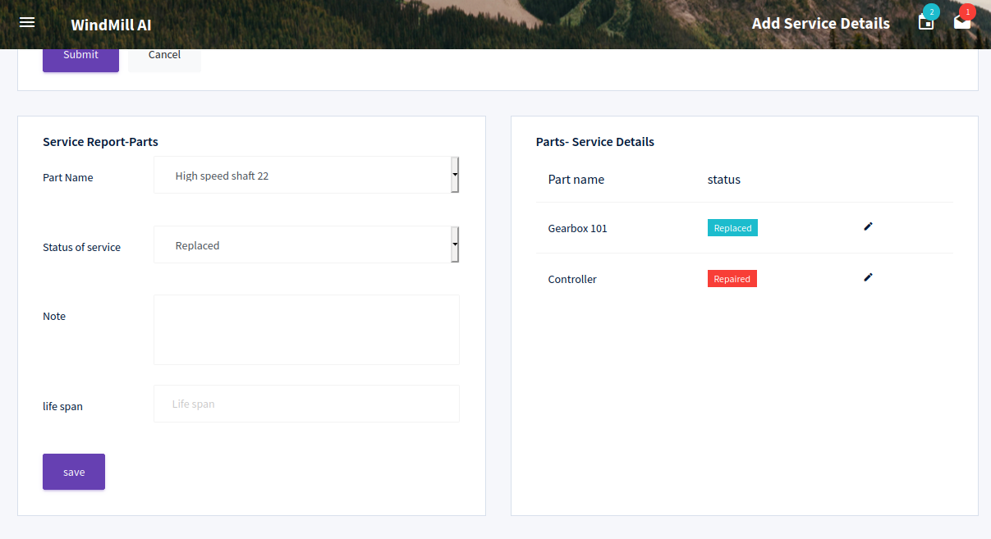
SERVICE REPORT 2

Slide 43
GIT HUB

Slide 44
GIT HUB

Slide 45
FUTURE ENHANCEMENT
Mobile application can be implemented with AR experience.
Additional use of online wind measurement data has the potential for improved forecasts, especially for very short-term and short-term wind power forecasting.
Forecasting extreme events, as opposed to common behavior, would be very valuable to protecting the power system.
Extending the forecasts further into the future, enabling long-term planning.
Further improvements in both physical and statistical forecasting approaches and improved approaches for the combination of different forecasting approaches can be expected to further reduce forecasting errors.

Slide 46
CONCLUSION
The main objectives of this project is to create a AI model for wind-turbine maintenance practices and can result in increased efficiency, better spare-parts forecasting, reduced downtime, and lower unplanned Maintenance costs.
The sources from which AI can pull information may include maintenance data, failure histories, and management software, which are used to create AI models of normal turbine behavior, which serve to quickly identify abnormalities and notify the wind-farm operator.
Many types of forecasts are possible, including power production, availability, spare parts needs, and other such use cases. Having such increased visibility provides tremendous benefits to wind-turbine operators.

Slide 47
REFERENCE
Books
Kenneth.S.Rubin, Essential Scrum: A Practical Guide to the Most Popular Agile Process, First Edition
Allen B. Downey Think Python: An Introduction to Software Design, Second Edition
Lei M, Shiyan L, ChuanwenJ, Hongling L, YanZ .A review on the forecasting of wind speed and generated power , Renew Sustain Energy Rev 2009
Websites
https://www.javatpoint.com/python-tutorial
https://www.tutorialspoint.com/python/index.html

Slide 48
THANK YOU

